Slide 1

Final Project Submission
Phase 2 final project submission
Students name: Matilda Odalo, Wyclife Orimba, Mark Bundi and Charles Kagwanja

Slide 2
Business Problem
The business problem in this scenario involves providing homeowners with advice on how to increase the estimated value of their homes through renovation projects.

Slide 3
Data Understanding
This project uses the King County House Sales dataset, which can be found in kc_house_data.csv.
The data is used to create regression models that predict the trend of house prices in relation to specific variables. The below are the libraries that we are going to use for our analysis.

Slide 4
Data Preparation
We prepared out data to be ready for analysis by handling missing values, outliers and changing of categorical data to numerical data to enable us use them in regression analysis easily.

Slide 5
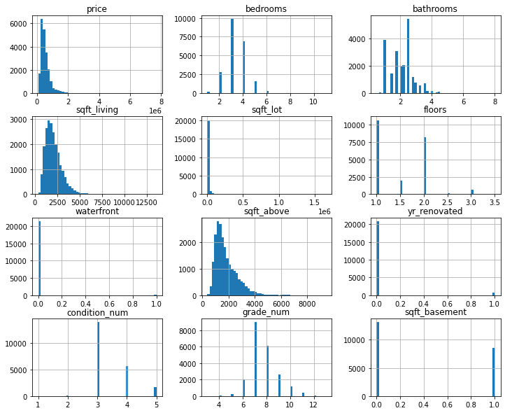
We then plotted a histogram to check for the distribution in each column including the price column as well as the correlation between the variables.

Slide 6
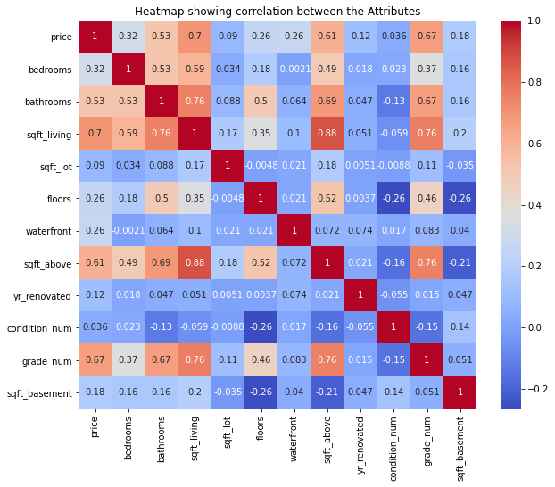
We also plotted a Heatmap showing correlation between the Attributes

Slide 7
Observations
The above Heatmap is just to show us how the independent variables are correlated with the dependent variable(price). sqft_living has a high positive correlation with price being 0.7 while condition_num has a low positive correlation with the price.

Slide 8
Modelling
Baseline Model
The baseline model is a simple model used to contextualize the results of trained models. We create the baseline model to provide a reference point for measuring the performance of other models. We start with a simpler model as our base and work through it to make a much better base. In this instance we used y = price as the dependent variable and square foot living independent variable

Slide 9
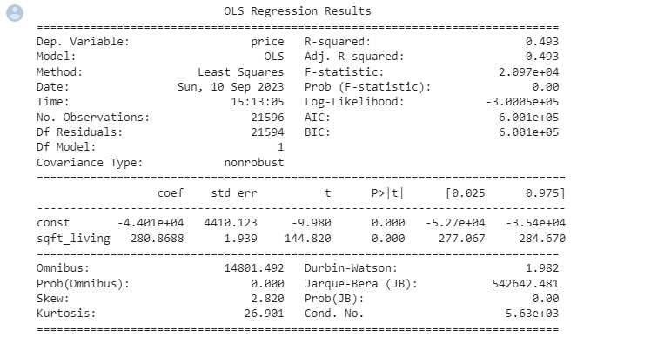

Slide 10
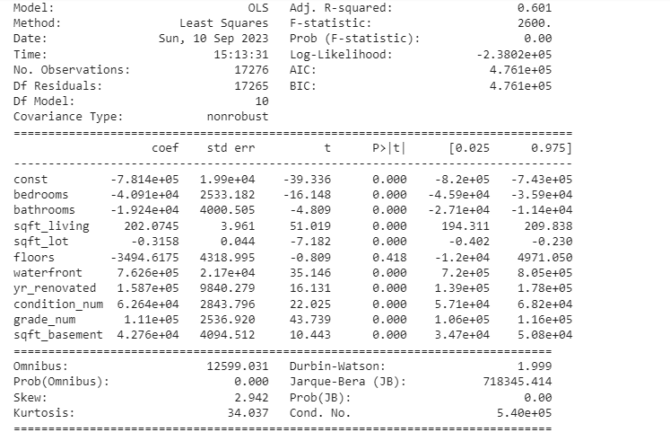

Slide 11
Observations
On our baseline model, we have an R-squared value of 0.601 meaning that 60.1% of variation in price is due to the independent variables. The RMSE of the train set is 232918.7 and the RMSE of test set is 229101.3.The baseline model also has a skew of 2.942 which means that it is positively skewed. This means the dataset has a high percentage of outliers. It has a high Kurtosis of 34.037 indicating the dataset has high outliers. We also note that Floor has a p-value of 0.418 which is greater than alpha(0.05) indicating that it is an insignificant feature.

Slide 12
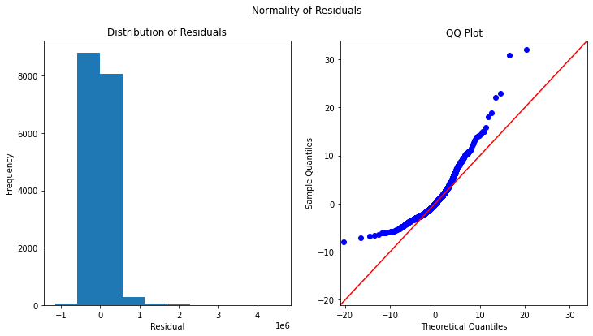
We also plotted a q-q plot to show the distribution of residuals

Slide 13
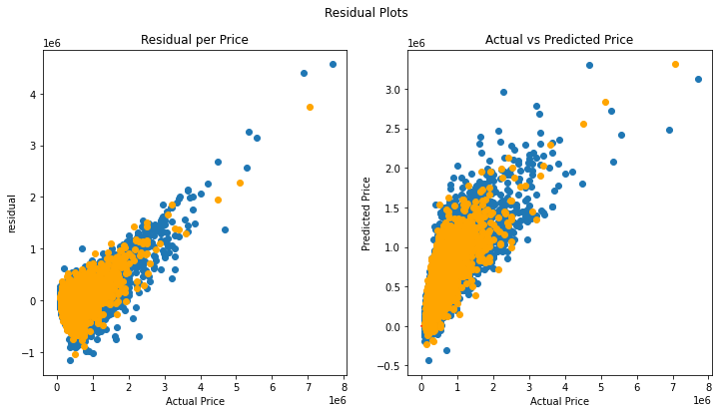
We note that the residuals are not normally distributed as per the below plots

Slide 14
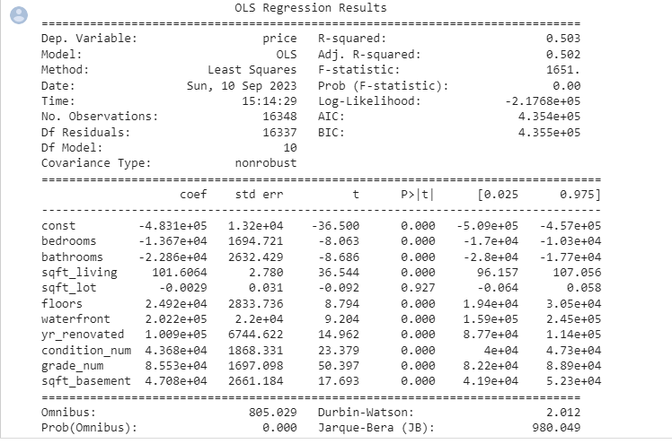
In our second model, we removed the outliers in order to improve our model. The summary of the model is as below.

Slide 15
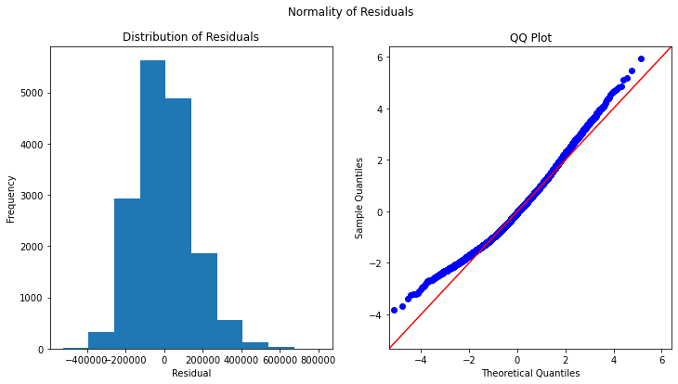
qq_plot after removing the outliers. We note that there is a modrate normal distribution of the data

Slide 16
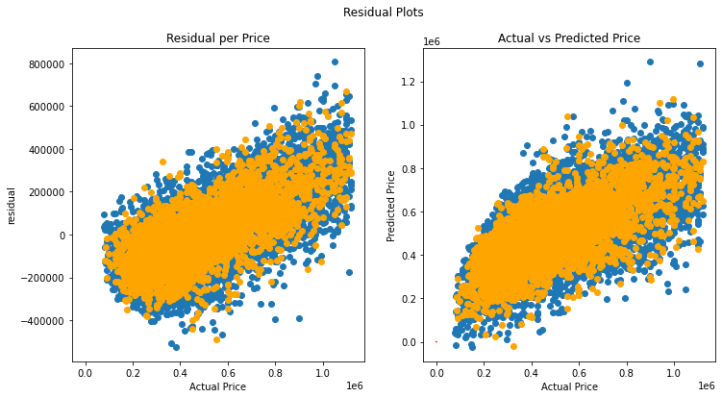

Slide 17
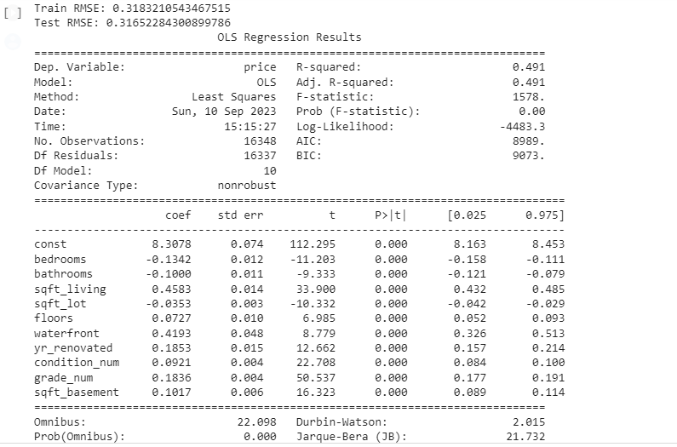
In our final model, We will try to do a log transformation to normalize the data further and the model summary results are as show below.

Slide 18
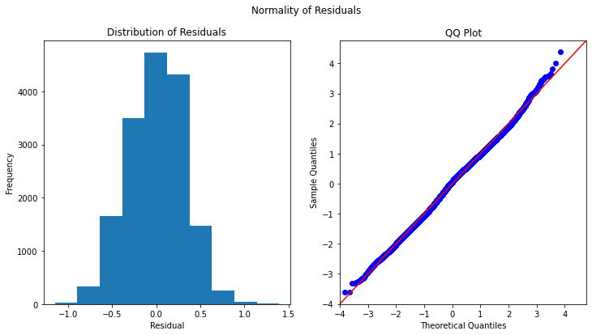
qq_plot after the log transformation of the data

Slide 19
Observations
On our model 1, we have an R-squared value of 0.491 meaning that 49.1% of variation in price is due to the independent variables.
The RMSE of the train set is 0.3183210543467515 and the RMSE of test set is 0.31652284300899786.
Model 1 also has a skew of -0.077 which is not very significant. The data is more normally distributed
It has a high Kurtosis of 2.910 indicating the dataset has few outliers.

Slide 20
Conclusion
The r squared of model one is 0.491 compared to 0.493 of our baseline model. Though it's a bit less than the baseline model, however the difference is not substantial.
"Model one" is considered a better model than the "baseline model" for several reasons, despite a slightly lower R²: It has significantly lower kurtosis, indicating that its residuals are closer to a normal distribution, which is an assumption of linear regression. It also has lower skewness, suggesting a more symmetric distribution of residuals.

Slide 21
Recommendations
From the regression model we can interpret that features that improve household value are in descending priority:
Square_foot living
Waterfront
Grade of the house
Renovation
The homeowner should focus on these features when renovating the house for maximum profits

